Slide 1
Project Title Image & Audio Captcha Generator
Presented by –
Shruti Uttarwar 2021BCS009
Hindavi Lande 2022BCS505
Roshan Vishwakarma 2021BCS155
Sushil Bhoybar 2021BCS073

Slide 2
Contents
What is Captcha?
Applications
Libraries used in this project.
Captcha generation Algorithm
Source Code
Output

Slide 3
What is Captcha?
It is a type of security measure known as challenge-response authentication.
CAPTCHA stands for "Completely Automated Public Turing test to tell Computers and Humans Apart."
CAPTCHAs are tools you can use to differentiate between real users and automated users, such as bots.

Slide 4
Applications
Preventing automated account creation.
For the protection of Online Polling.
Blocking spam email.
Protecting e-commerce websites.
Enhancing online security.
Web registration.
Preventing Dictionary Attacks
For preventing confidential web pages.
Preventing Bots in “Social Network”.
Detecting bots in “Online Games”.

Slide 5
Libraries used in this project -
from tkinter import *
import tkinter.messagebox
from captcha.image import ImageCaptcha
import string
import random
import os
import pyttsx3

Slide 6
3 Steps to generate Captcha with GUI
.
Algorithm of Captcha
Image & Audio Captcha
Make GUI

Slide 7
Step 1: Algorithm of Captcha
image_captcha = ' '
def generate_captcha():
data_set=list(string.ascii_letters+string.digits)
s=' '
for i in range(6):
a=random.choice(data_set)
s=s+a
data_set.remove(a)
global image_captcha
image_captcha=s
return s

Slide 8
Step 2: Generate Image & Audio Captcha
def generate_first_image():
img = ImageCaptcha()
s=generate_captcha()
value=img.generate(s)
img.write(s,"c1.png")
os.startfile('c1.png')

Slide 9
Step 2: Generate Image & Audio Captcha
def generate_audio_captcha():
s=generate_digit_captcha()
voiceEngine = pyttsx3.init()
voiceEngine.setProperty('rate',170)
voiceEngine.setProperty('volume',1.0)
voices=voiceEngine.getProperty('voices')
voiceEngine.setProperty('voice',voices[1].id)
voiceEngine.say(s)
voiceEngine.runAndWait()
voiceEngine.say(s)
voiceEngine.runAndWait()

Slide 10
Step 3: Make GUI

Slide 11
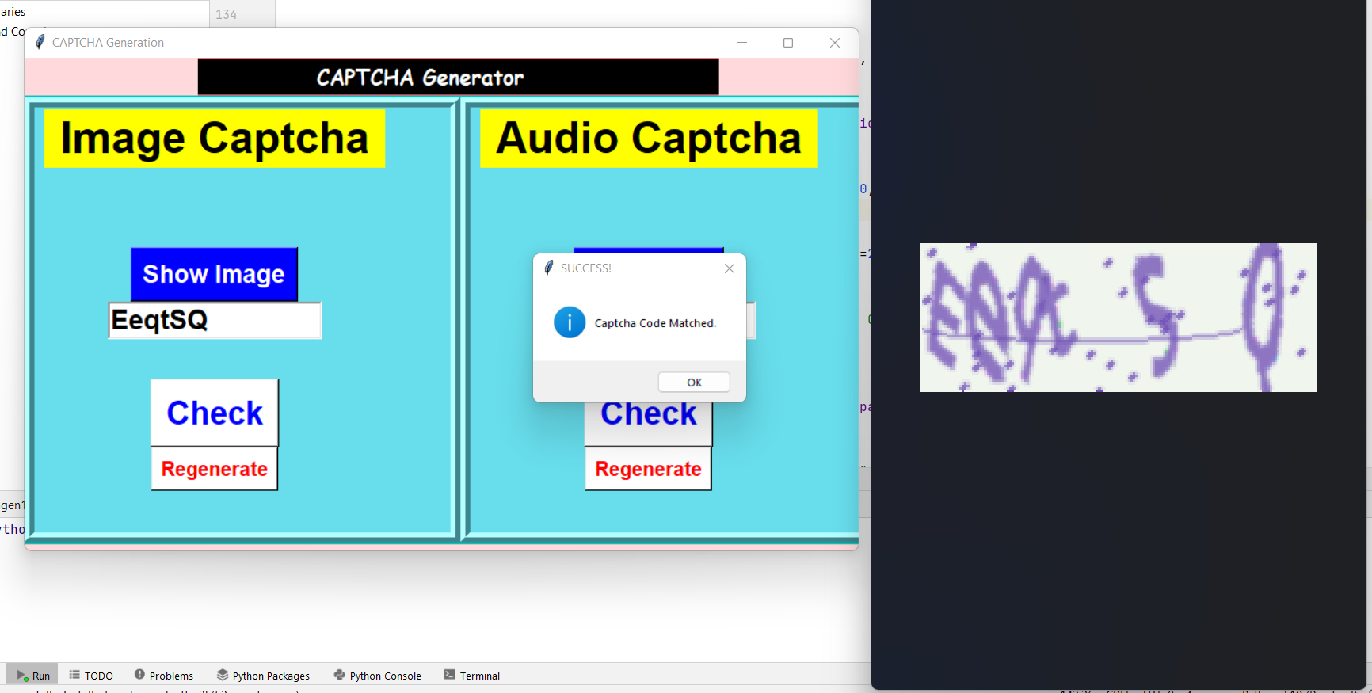
Output
.

Slide 12
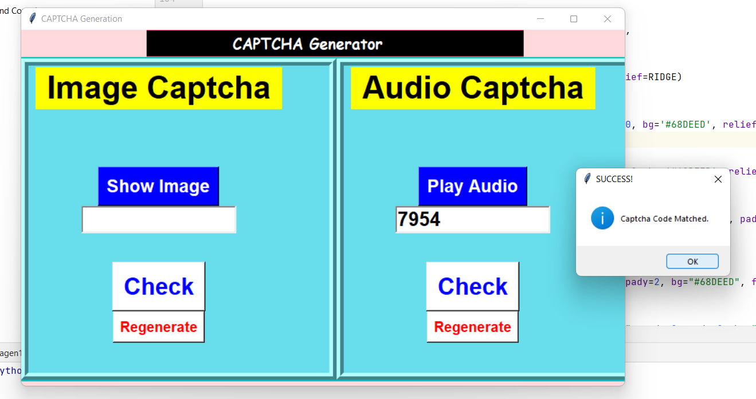

Slide 13
Thank You !

